Slide 1
Biobehavioral Measurements of alcohol use in a sexual minority drinking environment
Implications for prevention of alcohol related problems

Slide 2
Objectives
Describe sexual minority drinking environment as a risk environment
Understand alcohol use as coping behavior of sexual minorities
Identify unique prevention approaches for sexual minorities

Slide 3
Alcohol Use
Third leading lifestyle cause of death in the U.S.
Cause of death for 1 in 10 Americans
Excessive consumption results in:
  >79,000 deaths
  1.6 million hospitalizations
  > 4 million emergency room visits each year

Slide 4
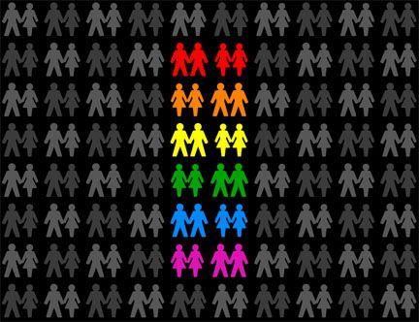
Sexual Minority
Notes:
This is an other category used to define individuals who are not sexual majority or heterosexual. Sexual minorities include…
From OxFam: “Sexual minorities can be defined as persons of a sexual orientation which is not part of the majority, or whose practices differ from the majority of the surrounding society. Initially, the term referred primarily to lesbians and gays, but it has come to include bisexuals and the wide spectrum of transgendered people: lesbians, male homosexuals (gays), bisexuals, the transgendered (those whose gender identity does not match their assigned sex) and inter-sexed (those whose biological sex cannot be clearly defined as male or female). These days, they are often referred to in short as LGBTI. This term also includes people who may not identify themselves in any such category but may practice the same sexual activities. An example of this is men who have sex with men but who do not perceive themselves as gay or bisexual.”

Slide 5
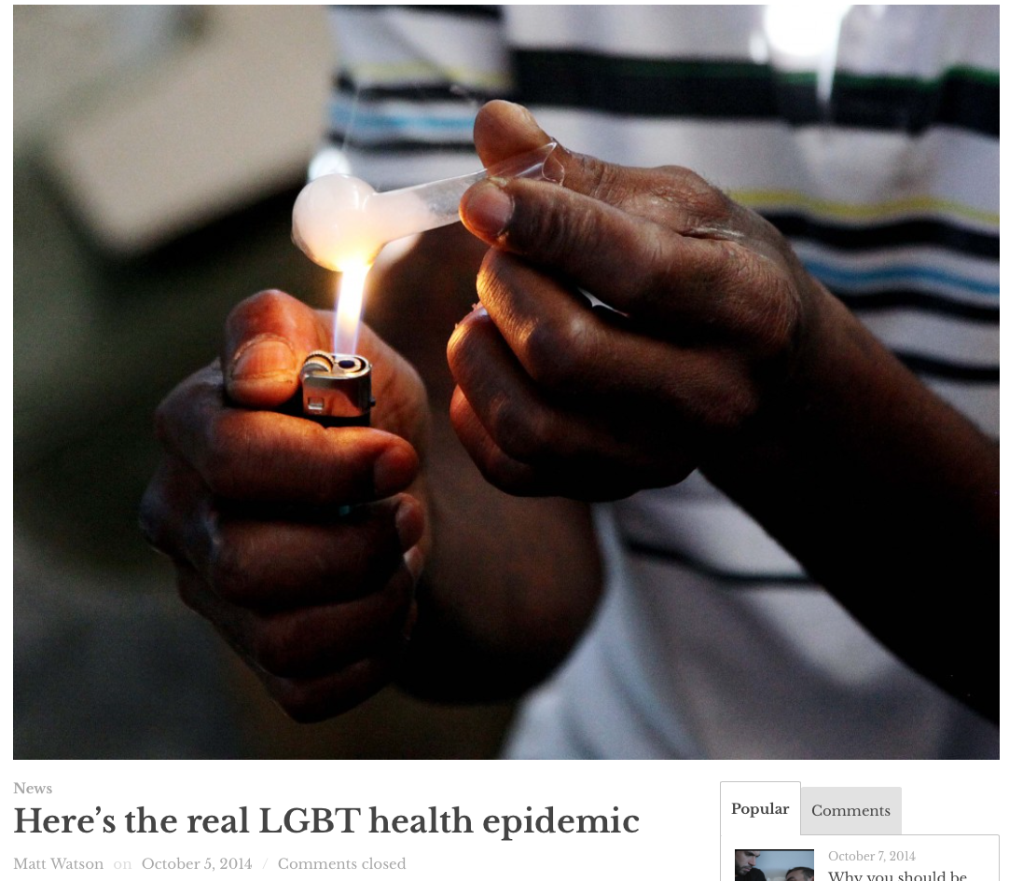

Slide 6
Sexual Minority Alcohol Use
Higher rates of alcohol use than heterosexual
Developmental in nature:
  Younger & Heavier (Corliss et al 2008)
  May be differential by gender (Hatzenbuehler, 2008)
Notes:
Begins at younger ages than heterosexual peers & is associated with higher rates of heavy episodic drinking (Corliss et al 2008)
HED = binge drinking
In a longitudinal study, Female sexual minorities drank at higher rates than heteroseuxal peers in high school; while male sexual minorities driank at higher rates than hetero peers during transition to college (Hatzenbuehler) -- this finding was not replicated among males in a national cross-sectional survey.

Slide 7
Alcohol Use Among MSM
Prevalent among urban MSM:
  85% reported using alcohol in the previous 6 months
  >12% reported 3+ alcohol related problems:
    Fear of dependence on alcohol
    Needing to have a few drinks in order to change a mood
    Loss of control once drinking starts
    Drinking to relieve a hangover
    Conflict with a lover or close friend
    Loss of a job due to drinking
  8% reported consuming 5 or more drinks in a sitting at least weekly.
          (Stall et al, 2001)
Notes:
A large scale random household survey identified few differences between the drinking patterns of homosexual and heterosexual men (Stall & Wiley, 1988).
*read slide*
Heavy alcohol consumption was also common among Latino MSM in Chicago and San Francisco: over a third of the Chicago sample and approximately one-sixth of the San Francisco sample reported heavy alcohol use (Ramirez-Valles, Garcia, Campbell, Diaz, & Heckathorn, 2008). This is particularly important given the large Latino population in San Diego.

Slide 8
Alcohol Use in Oklahoma: BRFSS
45.6% of adults who have had at least one drink of alcohol within the past 30 days
16.5% engaged in heavy episodic drinking (males having five or more drinks on one occasion, females having four or more drinks on one occasion)
5.5% are heavy drinkers (adult men having more than two drinks per day and adult women having more than one drink per day)

Slide 9
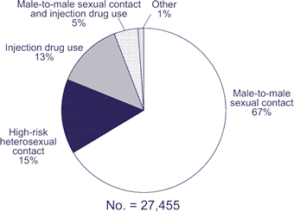
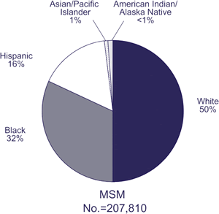
HIV Among MSM
Transmission categories of male adults and adolescents with HIV/AIDS diagnosed during 2005
Notes:
Immediate and short-term risks of alcohol use include: unintentional injuries, violence, alcohol poisoning, and unplanned or unprotected sexual behavior (Wechsler, Davenport, Dowdall, Moeykens, & Catillo, 1994; Smith, Branas, & Miller, 1998; Sanap & Chapman, 2003).
Risks of unprotected sexual behavior are particularly salient among men who have sex with men (MSM) because they continue to make up a large proportion of HIV cases: 67% of HIV infections among men are through unprotected sexual contact with another male (CDC, 2005). (Chart on left)
Chart on right – 2005 number of MSM currently living with HIV/AIDS in the US

Slide 10
Methodological Approaches
(Leigh and Stall, 1993)

Slide 11
Global Association Studies
Examine correlations between alcohol use and risky sexual behavior
Limitations:
  Preclude identification of causation
  Fail to assess frequency of sexual activity under the influence
Findings:
  Alcohol associated with 30% increase in UAI among MSM in SF (Eckstrand & Coates, 1990)
  High rates of unprotected sex reported among MSM entering outpatient alcohol/drug treatment (Paul, Stall, & Davis, 1993).
Notes:
Findings:
heavier drinkers have more sexual partners and use condoms less consistently

Slide 12
Situational Association Studies
Examine association between number of high-risk sexual behaviors and number of sexual behaviors that occur under the influence
Limitations:
  Fail to determine if risky sex and intoxicated sex occurred on same occasion
Findings:
  More UIAI among those who drank alcohol more frequently before or during sexual activity (Purcell, Parsons, Halkitis, Mizuno, & Woods, 2001).

Slide 13
Event-level Studies
Correlational studies which ask the participant to recall any alcohol and condom use during a person’s last sexual encounter.
Limitations:
  Poor response rates
  Last event may not be representative of typical behavior
  Fail to address potential confounding personality characteristics
  Fail to measure variance in level of intoxication
Findings
  Meta-analysis only identified relationship during first sexual intercourse (Leigh, 2002).
Notes:
In a retrospective study over a period of 6 months, MSM were 4 times more likely to have unprotected sex with a casual partner after drinking than when sober (Seage, et al., 1998). Another event-level study identified that MSM who reported consuming 4 or more drinks where three times more likely to engage in unprotected anal sex with a casual sexual partner (Vanable, et al., 2004). In a meta-analysis of event level studies, however, Leigh identified a relationship between alcohol consumption and risky sexual behavior only during first intercourse and failed to identify a relationship in recent sexual encounters or during recent encounters with new partners (Leigh B. C., 2002). Many of the studies included in this meta-analysis, however, were among heterosexual adults; it is conceivable that sexual risk behaviors differ between young heterosexual adults and MSM.

Slide 14
Event Level (Cont'd)
Additional/new methods:
  Timeline Follow-Back (TLFB)
  Diary Studies
Findings:
  Drinking increases sexual risk taking (Irwin, Morgenstern, Parsons, Wainberg, & Labouvie, 2006)
  Alcohol use significantly increased the odds of engaging in sexual activity and sexual risk. This relationship was moderated by age (Mustanski, 2008).
Notes:
These methodologies allow us to look at multiple events – therefore eliminating the potential that the last event was somehow uncharacteristic of the person’s typical behavior.
A TLFB of MSM with alcohol abuse problems suggests that drinking increases sexual risk taking (Irwin, Morgenstern, Parsons, Wainberg, & Labouvie, 2006)
Mustanski identified significant within- and between-subjects associations linking alcohol consumption with risky sexual behavior in a diary study of HIV-negative MSM (Mustanski, 2008). In this study alcohol use significantly increased the odds of engaging in sexual activity and also increased sexual risk. Further, age was identified as a significant moderator of this relationship: effects of alcohol on sexual behavior increase with age (Mustanski, 2008).

Slide 15
Experimental Studies
Manipulation of alcohol use in order to test a change in sexual risk behavior.
Limitations:
  Poor response rates
  May fail to address potential confounders
Findings:
  In a natural experiment, increases in alcohol taxation were associated with reductions in STD rates.
Notes:
Randomized controlled trials of alcohol interventions improve upon the explanatory power of other correlation studies by directly manipulating the variable of interest: alcohol consumption. Based on the extant correlational evidence, a reduction in alcohol consumption on a given night should theoretically result in reduction in unprotected sex.

Slide 16
Conceptual Approaches
(Cooper & Orcutt, 2000)
Notes:
There are a few ways to interpret the relationship between alcohol use and risky sexual activity… identifying the appropriate conceptual model for this is as important as …
Alcohol use behavior could influence sexual risk through (1) an increase in the number of sexual partners or (2) from a reduction in use of condoms or (3) through some combination of these behaviors. The risk from additional sexual partners is only noteworthy when condoms are not used. Risky sexual behaviors are therefore defined by condom use behaviors with non-monogamous sexual partners.

Slide 17
Model A
Casual Partner
Condom Use
Alcohol Use
Notes:
Cooper & Orcutt, 2000 – in JSA
We know that having sex with a casual partner is more likely to involve condom use than sex with a regular or primary sexual partner.
Although less well researched, a positive association has also been found between having a casual partner and drinking proximal to intercourse.
And as previously discussed, it is possible that alcohol use has some direct negative effect on condom use.

Slide 18
Model B
Casual Partner
Condom Use
Alcohol Use
Notes:
Another way to look at this information is in model B:
We still acknowledge the relationship between casual partnership and condom use.
Because we don’t know as much about the relationship between alcohol use and casual partnerships, the relatinoship is reversed in this model.
And as previously discussed, it is possible that alcohol use has some direct negative effect on condom use.

Slide 19
Model C
Casual Partner
Condom Use
Alcohol Use
Setting
Notes:
We know that having sex with a casual partner is more likely to involve condom use than sex with a regular or primary sexual partner.
And as previously discussed, it is possible that alcohol use has some direct negative effect on condom use.
In this model, however, we note that the setting may play a role in linking alcohol use and casual partnerships. This setting is a risk environment for both alcohol-related problems as well as sexual relationships with casual partners.

Slide 20
Risk Environment
Alcohol Risk Environment
  Cavan, 1966
  Loud music & increased alcohol consumption (Grueguen, et al., 2004; van de Goor, et al., 1990)
  Functions of access within bars (Clapp et al., in press; Thombs, et al. 2008)
HIV Risk Environment
  “The space, whether social or physical, in which a variety of factors exogenous to the individual interact to increase vulnerability to HIV,” (Rhodes, Singer, Bourgois, Friedman, & Strathdee, 2005).
Notes:
Bars afford access to alcohol and the opportunity to meet new sexual partners (Cooper & Orcutt, 2000).
The gay bar can be conceptualized as a risk environment for alcohol related problems and HIV transmission.
The relationship between the bar environment and intoxication is better understood than the role of the bar as an HIV risk enviornment. In her ethnographic study of bars, Cavan describes the social and physical environment and how this environment influences intoxication (Cavan, 1966).
Quantitative studies have demonstrated an association between loud music at bars and increased alcohol consumption (Gueguen, LeGuellec, & LeGuellec, 2004; van de Goor, Knibbe, & Drop, 1990).
Functions of alcohol access within the bar (e.g., drink specials, bar server training, and temporary bars) also impact consumption and alcohol-related problems (Clapp, et al., In Press; Howard-Pitney, Johnson, Altman, Hopkins, & Hammond, 1991; Saltz, 1997; Thombs, et al., 2008).
In a study of young-adult oriented bars, that person-level variables better predicted breath alcohol concentration than did bar-level variables (Clapp, et al., In Press). Person-level predictors included drinking intentions and plans to continue drinking (Clapp, et al., In Press). Intervening at the person-level with a brief intervention of drinking intentions is, based on this research, the appropriate course of action.
Patrons of gay bars often rely on these settings as locations to meet future sexual partners and are, therefore, at increased risk of alcohol-related problems (Green & Plant, 2007).
Gay bar attendance has been shown to be predictive of HIV risk among MSM with steady partners, even when controlling for alcohol consumption (Fergus, Lewis, Darbes, & Butterfield, 2005). The social and physical aspects of bar environments that contribute to the relationship between gay bar attendance and sexual behavior, however, are not completely clear.

Slide 21
Structural Stigma
Structural Stigma
  Limits opportunity or resources for stigmatized populations, thereby increasing stress associated with living as a sexual minority
  (Corrigan et al, 2005; Link & Phelan, 2001)
Notes:
Stigma exists on multiple ecological levels.
Structural stigma is a term used to describe the exo system of influence from policy, culture, norms etc.
This stress experienced by sexual minorities is one proposed

Slide 22
Structural Stigma (Cont’d)
Sexual minorities living in high structural stigma communities were 34% more likely to die from cardiovascular disease
Reduces lifespan of sexual minorities (estimates range include up to 20 years)

Slide 23
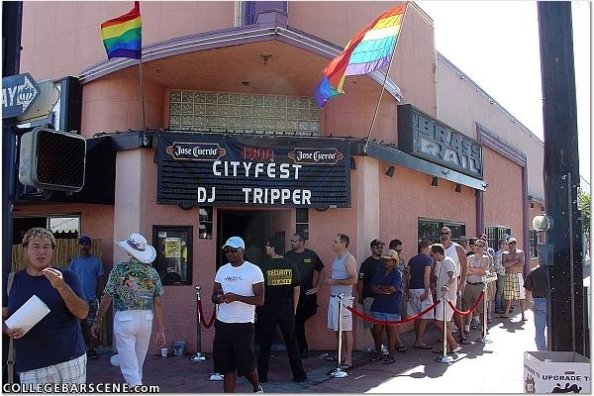
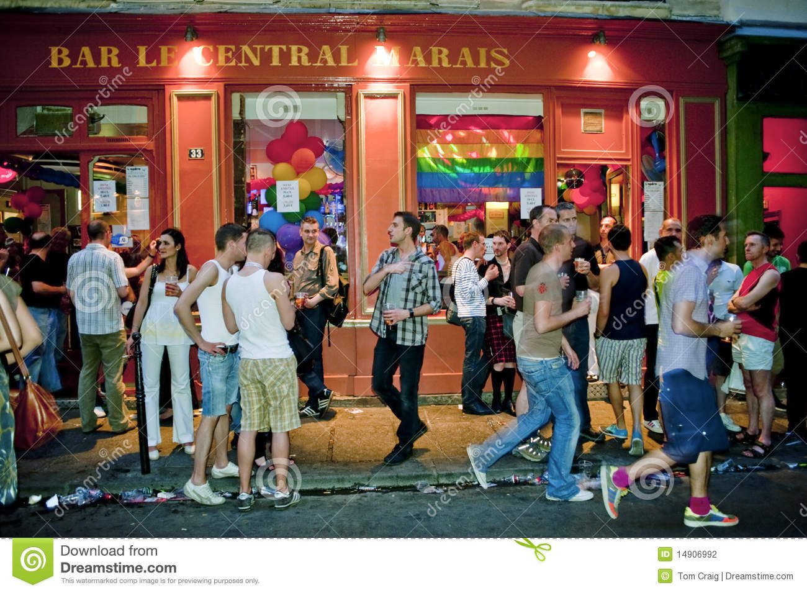
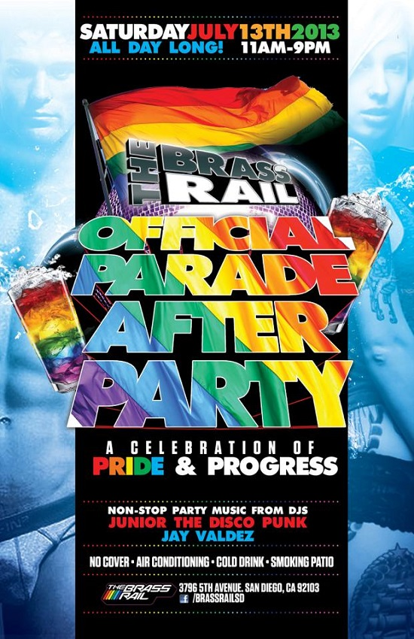
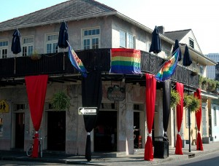
Interpersonal Stigma
Notes:
Hate crimes – define interpersonal stigma when taken to extremes
This may influence the environment of gay and lesbian bars
Being able to locate/identify gay and lesbian bars is important for a sense of community. Although this is not the ONLY type of location that bridges and creates community, it has historical routes in the civil rights movement. Since Stonewall the bar has been one of the cornerstones of the sexual minority environment. Most major US cities have blocks dedicated to sexual minority drinking districts.

Slide 24
Motivation to Drink
Coping (reduce negative emotion)
  Specifically, escape is the self-medicating maladaptive coping mechanism
Social (increasing comfort in social situations)
Enhancement (increasing positive emotions)
Notes:
Finally – individuals may self-stigmatize, which is commonly called internalized heterosexism or internalized homophobia.
Motivation to drink has been conceptualized in three ways – coping, social, and enhancement. Alcohol use motivated by coping is more frequent, and is associated with higher rates of alcohol-related problems.

Slide 25
“Sometimes, you just want a place where you know you’re going to be with other LGBT people. [Bars are] still one of the few places you walk in and you’re with your people,” Ellen Kahn, director of the Human Rights Campaign Foundation’s Children, Youth and Families Program told me.
Notes:
I would note that this exemplifies social and enhancement motives – sense of belonging in a sexual minority drinking environment serves to enhance mood.

Slide 26
Model D
Enhancement
Social
Coping
Casual Partner
Condom Use
Alcohol Use
Setting
Notes:
We know that having sex with a casual partner is more likely to involve condom use than sex with a regular or primary sexual partner.
And as previously discussed, it is possible that alcohol use has some direct negative effect on condom use.
In this model, however, we note that the setting may play a role in linking alcohol use and casual partnerships. This setting is a risk environment for both alcohol-related problems as well as sexual relationships with casual partners.

Slide 27
Methods

Slide 28
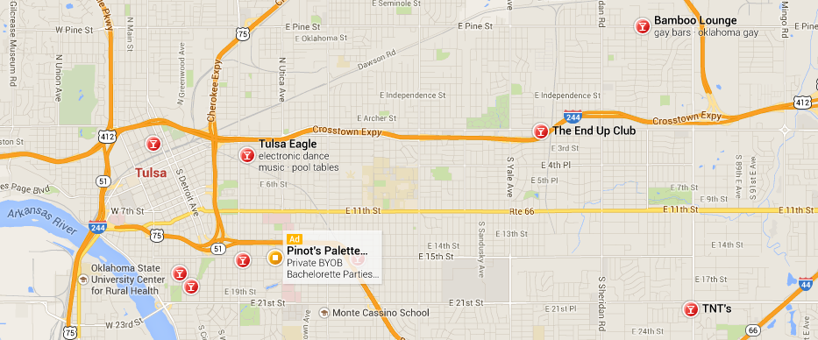
Tulsa Sexual Minority Bars
Notes:
Research team consisted of one paid graduate research assistant and many volunteer undergraduate students who wanted research experience. The team typically consisted of at least 6 individuals. One individual would be a dedicated rectuiter, four to conduct surveys and breath samples, and the graduate student to ensure that the process was running smoothly and to supervise data collection and collection procedures.
Identified sexual minority serving bars in Tulsa metropolitan area
Note that these bars are widely dispersed throughout Tulsa.
Asked permission of bar managers to conduct research at the bar; Chose bars that were oriented toward males, or gay bars.
Sampled each bar on two nights.

Slide 29
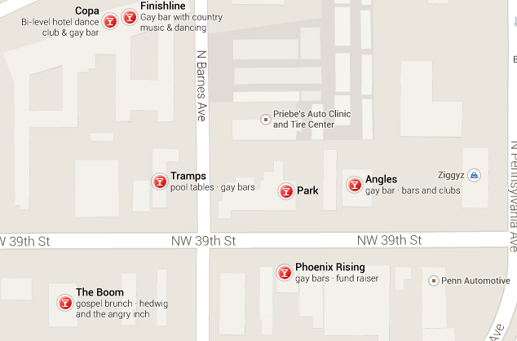
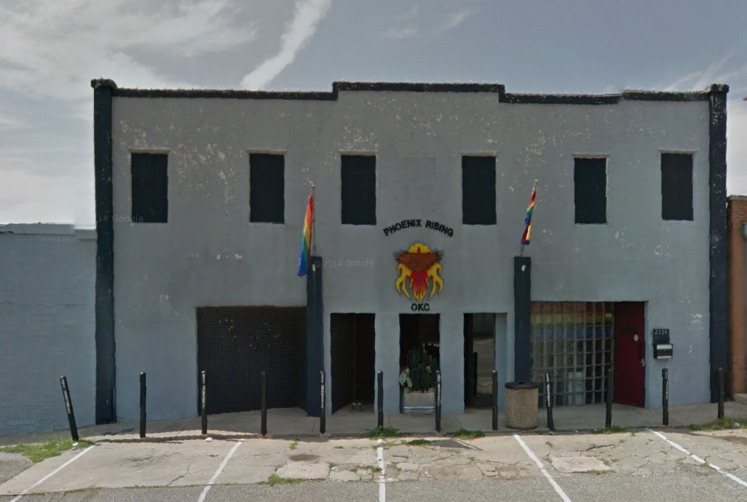
Oklahoma City Sexual Minority Bars
Notes:
By contrast, the sexual minority drinking environments in OKC are centralized – and clearly look like gay bars

Slide 30
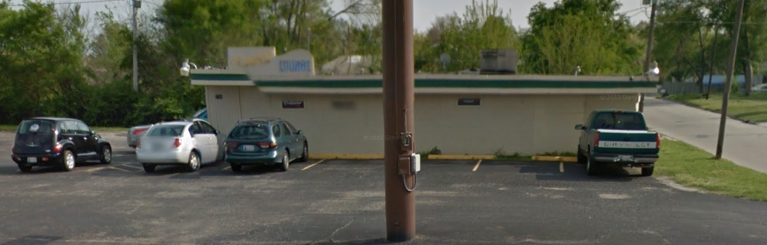
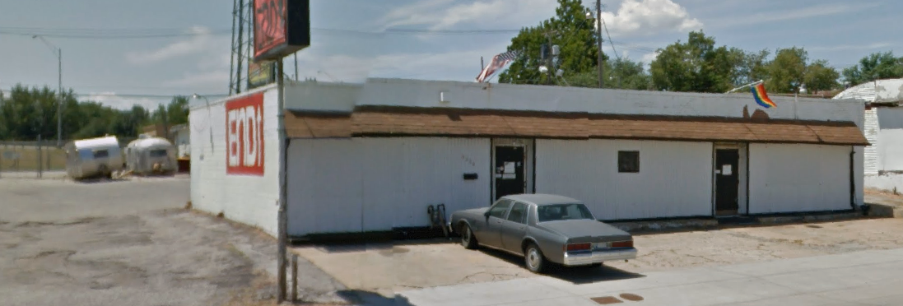
Bars in Tulsa
Notes:
Team set up outside of a bar on a given night between 9 and 9:30 – identifying all entrance and exits.
Groups of subjects were recruited for participation following a random interval. A die was rolled the day of data collection to determine the recruitment interval (1 – 6).
After consent participants were recruited to participate in a 4 week telephone follow-up survey. – this will be

Slide 31
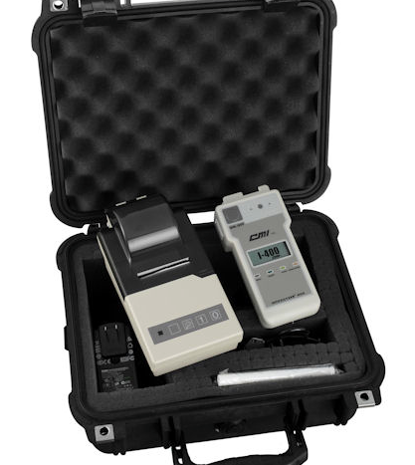
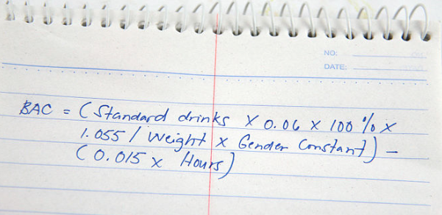
Notes:
Participants who agreed to participate were asked to give a breath sample and complete a brief survey before entering the bar.
Participants were given a wrist band with their unique identifier written on it.
They were identified by the wrist band at exit from the bar, asked to complete another brief survey and to give a final breath sample.
Breath values are more reliable than calculating BAC from self-report. Participats drinking in bars do give a more accurate representation of the number of drinks consumed; however, gender questions among sexual minorities may be misleading (gender versus sex), and many individuals misreport weight and drinking time. In Oklahoma, this is further complicated by the 3.2 versus full point beer consumption – many consumers may not know which type of alcohol they are consuming.

Slide 32
Results

Slide 33
4 Bars – 7 nights
Bar Number | Sample
1 | 23
2 | 47
3 | 44
4 | 13
Total | 127
Notes:
Recruited a total of 127 participants… Lost 17 before exit from the bar – 110 completed the exit survey
While there is nesting by bar and by night of data collection, the sample sizes are insufficient to

Slide 34
Demographics | N (%)
Gender
Male | 77 (60.6%)
Female | 48 (37.8%)
Sexual Minority Status
Yes | 54 (49.1%)
No | 56 (44.1%)
Race
White | 82 (64.6%)
Other | 45 (35.4%)
Age | Mean 30.43 (SD 8.6) Range 21-58
Notes:
Gender & race were measured at entrance
Sexual minority status measured at exit

Slide 35
Education | N (%)
Some HS | 4 (3.7%)
HS Graduate | 24 (22.4%)
Vocational or Technical | 4 (3.7%)
Some College | 31 (29.0%)
Current College: Freshman | 4 (3.7%)
Current College: Sophomore | 1 (0.9%)
Current College: Junior | 6 (5.6%)
Current College: Senior | 3 (2.8%)
College Graduate | 17 (15.9%)
Graduate/Professional School | 10 (9.3%)
Notes:
Education status of the sample varies widely. Generally, majority of participants had not completed a 4-year degree.

Slide 36
Motivations | N (%)
Socialize | 92 (73.6%)
Meet a sexual partner | 6 (4.7%)
Fun | 44 (34.6%)
To get drunk | 15 (11.8%)
To get in a fight | 1 (1.6%)
To unwind | 15 (11.8%)
I had a stressful week | 7 (5.5%)
Notes:
Education status of the sample varies widely. Generally, majority of participants had not completed a 4-year degree.

Slide 37
Breath Samples
 | Mean (SD) | Range
BrAC at Entrance | 0.039 (0.066) | 0 – 0.40
BrAC at Exit | 0.061 (0.066) | 0 – 0.29

Slide 38
Bivariate Analyses
BrAC at entrance & BrAC at exit R = 0.59**
Had Alcoholic Drinks (at Entrance) | BrAC at exit mean (SD)
Yes | 0.093 (0.65)
No | 0.030 (0.05)
F = 3.50 p<0.10
Transportation Plans (at Entrance) | BrAC at exit mean (SD) | n
Drive Self | 0.030 (0.05) | 51
Ride with Someone Else | 0.085 (0.075) | 48
Bike/skateboard | 0.082 (n/a) | 1
Other | 0.20 (n/a) | 1
F = 7.46 p<0.001
Notes:
Use chi squre and t-tests as appropriate to test the bivariate relationships. Although only entrant BrAC, pre-drinking, and transportation plans were identified as significant bicariate predictors of BrAC at exit, the demographic variables and bar number were retained in the final model.

Slide 39
Bivariate Analyses
Stress Motivation | BrAC at exit mean (SD)
Yes | 0.103(0.119)
No | 0.059(0.063)
F = 7.48 p<0.01
Notes:
Only statistically significant predictor of BrAC at exit. – note endorsed by only 7 people

Slide 40
Structural Equation Model
Notes:
Here – we switch from SPSS output to Stata output. I had a substantial amount of missing exit BrAC data. Using the FMIL function – created 50 iterations of datasets to approximate the missing data.
Technically this model should control for effects of nesting by night of data collection and by bar; however, the small sample size limits multi-level analyses that can be conducted on this data.
We are able to control for demographic characteristics and for the bar environment, generally. The bar itself has no influence on BrAC at exit from the bar; however, drinking behaviors before entering and plans for getting home are significant predictors of BrAC at exit from the bar.

Slide 41
Discussion

Slide 42
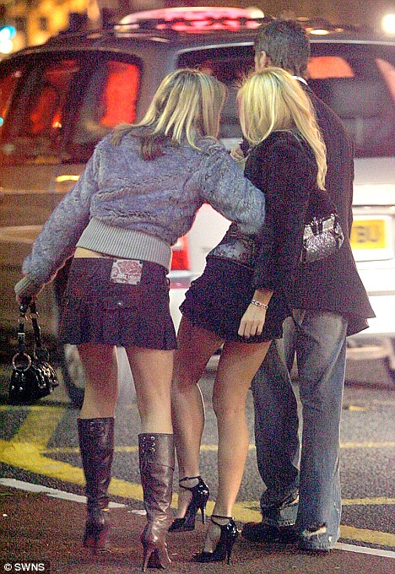
Changes in BrAC
Notes:
Previous research suggests 0.05 increases in BrAC regardless of consumption before entering the bar… so a sober person would be likely to leave the bar with a 0.05 BrAC and someone who had been drinking would be higher. We see a differential effect in this study.
Individuals who drank before the bar increased BrAC by a mean of 0.06
Individuals who entered the bar sober increased BrAC by a mean of 0.03 standard deviations are identical.

Slide 43

Transportation
Notes:
Typically, transportation home from a drinking environment is the key risk factor for individuals. However, this sample was one of the first that is very safe. If individual plan to drive, they are well under the legal limit (on average) and below the level of deteriorating effects of driving at 0.05.
To explain this phenomenon, we need to return to the interpersonal stigma piece from the introduction. There is only one cab company in the Tulsa metropolitan area that the bars trust to get patrons home. Patrons don’t drink to excess when planning to drive because there is no alternative – there is no one else to help.

Slide 44
Prevention Approaches: Policy
Equal status
Equal rights
Job Protection
Notes:
Approaches which may address structural stigma – if addressed from ground up are more meaningful.

Slide 45
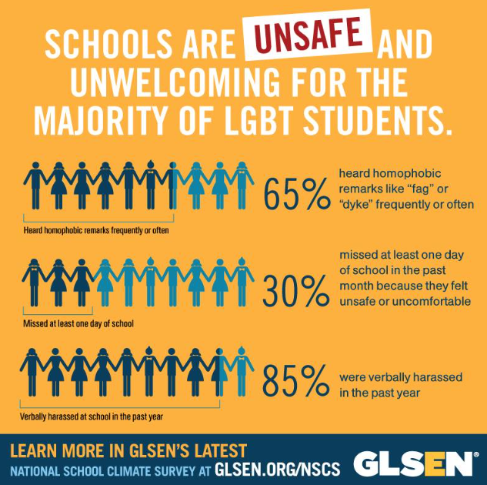
Notes:
Policies of inclusion help children in schools; universities; and protect rights in the job market

Slide 46
Prevention Approaches: Family
Positive Parenting
  20% of homeless youth are LGBT compared to 10% of general population
  LGBT twice as likely to experience exual abuse before the age of 12
  58.7% of LGBT homeless youth have been sexual victimized compared to 33.4% of heterosexual homeless youth
  LGBT youth are roughly 7.4 times more likely to experience acts of sexual violence than heterosexual homeless youth
  LGBT homeless youth commit suicide at higher rates (62%) than heterosexual homeless youth (29%)
Notes:
Stats from national alliance to end homelessness
Overall 50% of homeless youth were asked to leave by a parent.

Slide 47
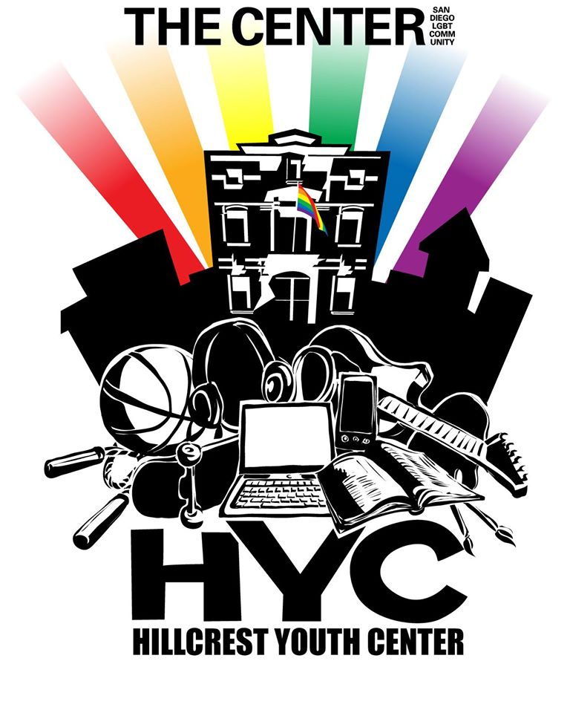
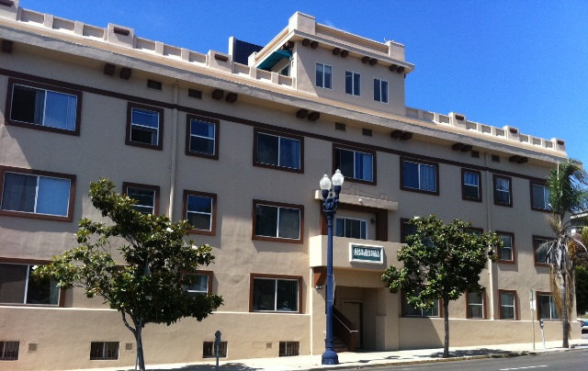
Prevention Approaches: Community
Notes:
Hillcrest youth center – drop in space for youth age 14 – 18.
Youth supportive housing project. This cutting-edge program is one of the first projects of its kind in the United States. The Youth Housing project provides 23 units of affordable, supportive housing for youth between 18-24 years of age, with a special focus on LGBTQ+ youth. These high-risk youth were living in the streets or in public spaces after having been ejected from their homes because of their sexual orientation.
Programs in tulsa are for homeless youth in general, but are accepting of LGBT youth.

Slide 48
Prevention Approaches: Inter & Intra-Personal
Acceptance
Social Support
Teaching positive coping behaviors

